Slide 1
Assignment 1
CENG 256

Slide 2
Overview
Group Project (2-4 students per group)
Start Week 2 (Today)
Due Week 7 (It will be marked during the lab session)

Slide 3
Objectives
Objective complete a multi page website showing DOM Manipulation and basic client side validation using JavaScript.
Review and expand you knowledge of HTML5 and CSS to create a professional site.
Note: This is also a RESEARCH project. This means you will have to learn on your own how to achieve certain aspects or effects.

Slide 4
Approach
Read specification document and discuss with group
Design, implement and test each feature (Page)
Complete all features and test the application end-to-end
Implement any required fixes or changes to improve the quality of the application
Submit the completed (.zip) package before the due date

Slide 5
Requirements – Part 1
You are required to make a 7 Page website Front-end section (Using HTML5, CSS and Javascript or/and JQUERY)

Slide 6
Required Pages
Major Pages
HomePage
Information Page
Feedback Form Page
Login Page
About Us page
Minor Pages
Confirmation of Feedback form Page
Successful Login Page

Slide 7
HomePage Requirements
Pictures that change every few seconds using Javascript ( at least 3 pictures)
Contains information and links to all the other pages.
Information about the product or service offered
A copyright in the footer with the student names and id numbers

Slide 8
About Us Page
A copyright in the footer with the student names and id numbers
A brief bio on each student involved in the project.
Links to all the other pages

Slide 9
Information Page
Contains information about the product or service. It can be technical or about its uses etc.
Must have 3 Javascript enabled DOM manipulations shown. Such as expandable sections of text. Images that change on events etc.
Has links to all the other pages

Slide 10
Feedback Form Page
You form must have at least 2 text boxes. One of which is a required field (example for the name of the person)
One (1) textarea (example for comments)
At least 1 radio button or checkbox
A submit button that links to the Feedback thank you page.
NOTE: the submit button must only transfer to the new page when the form has been validated
Has links to all the other pages

Slide 11
Examples
https://www.humber.ca/vpacademic/content/contact-feedback
http://www.mcdonalds.ca/ca/en/how_can_we_help/Talk_to_Us.html

Slide 12
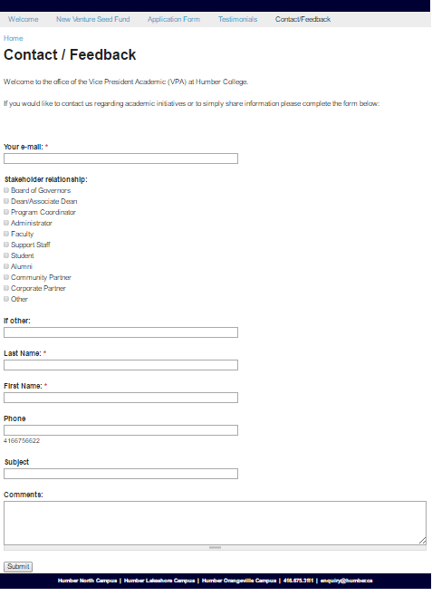

Slide 13
Confirmation of feed back form Page
Must show a thank you for the completing the survey.
Has links to all the other pages

Slide 14
Login Page
Has two text fields for available entry of information.
One for username
One for Password
Must have instruction of username and password requirements
Javascript must be used to check password and username fields and display errors where necessary.

Slide 15
Login page username and password specifics
Username specifications:
must be all letters and numbers.
Must begin with a letter
Password specifications:
Must be 8 to 16 characters long
Must start with a letter
Has at least one ! Or * in it
Has as least 1 digit in it

Slide 16
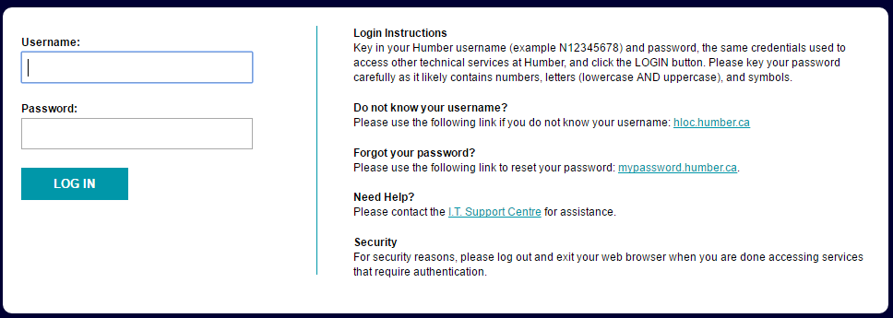
Examples
Humber Black board login Page

Slide 17
Successful Login Page
Must show a Success message.
Has links to all the other pages

Slide 18
Evaluation
Evaluation Item | %
Implementation of the Specifications | 75
UI layout and use of HTML and CSS | 15
Professionalism and realism | 5
Coding Guidelines and naming conventions | 5

